Slide 1


Offline Impact Assessment of Dynamic Simulations in the
EU FP7-funded iTesla Project
Dr. Rafael Segundo
KTH SmarTS Lab (rafael.segundo@kth.se)
Prof. Luigi Vanfretti
KTH SmarTS Lab (luigiv@kth.se), Statnett SF (luigi.vanfretti@statnett.no)
PES GOLD Panel Session
IEEE PES GM July 22, 2013 – Vancouver, Canada

Slide 2


Project description
A EU-funded FP7 project coordinated by RTE
7 transmission network operators (RTE, Statnett, National Grid, Elia, REN, Coreso, IPTO), 7 SMES, 3 R&D centers and 3 Universities (KTH, Imperial College and KULeuven)
4 years of duration, 13.2 M€
Main objective: to develop a toolbox for use of TSOs to operate the European power system in the years to come
To validate the toolbox at the pan-European level
The toolbox will allow to assess the (dynamic) security of the power system from 2-days ahead to real-time and provide preventive or curative actions when needed
Considers six large challenges – two of which are:
To take into account system dynamics in security assessment
To take into account large networks with a need for coordination

Slide 3
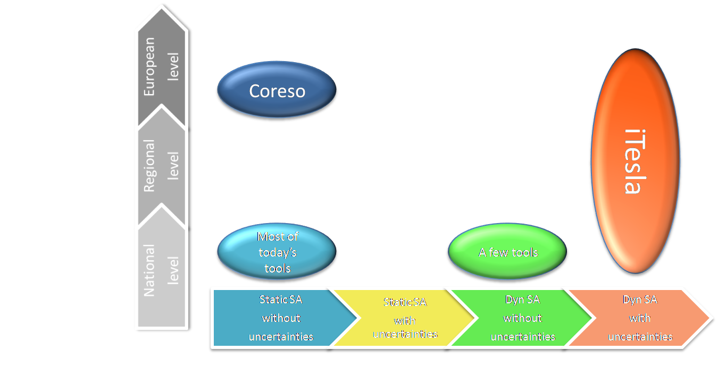
Overview of iTesla
The iTesla toolbox addresses :
Decision making under uncertainties,
New flexibility brought by corrective actions,
Dynamic modeling and simulations.
With the help of:
High performance computing,
Data mining techniques.
Will be a major improvement in security assessment tools.

Slide 4
Indices for Impact Assessment
The impact assessment is part of the offline analysis aim to provide criteria to the online analysis.
Following a dynamic simulation for a specific contingency, the output data is used to calculate a set of severity indices. These indices, should measure the quality of the stability or severity of the instability.
The indexes will indicate:
If the system will converge to a safe and stable equilibrium point.
To indicate the severity of the instability/stability for each type instability mechanism
Static concerns |  | Dynamic concerns
1. Post-fault overloads of lines | 2. Post-fault bus under- or over-voltages | 3. Small-signal stability | 4. Transient stability

Slide 5
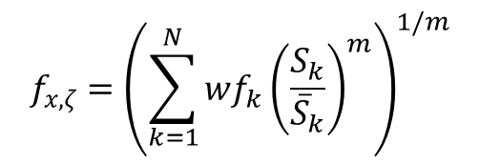
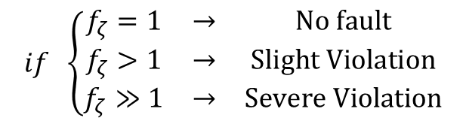
1. Post-fault Overloads Index
Indicate if the post-fault line flows exceed the network capacity by observing the power flows through the transmission lines after an outage occurs.
Weighting factor
i.e. wfk=[1,1,…,1] for a uniform weight
Parameter (from choosing a m-norm)
post-fault flow trough transmission line k
(from dynamic simulation)
Capacity of transmission line k (from network data)
$$if \left\{\begin{matrix}f_{ζ}=1 & → & No fault \\ f_{ζ}>1 & → & Slight Violation \\ f_{ζ}≫1 & → & Severe Violation\end{matrix}\right.$$
Index Classification
The index is not a simple summation, it is in fact a norm (or pseudo-norm if m<1): the term wfk can be used to weight and give more importance to specific lines.

Slide 6
Overloads: Case study 1
Case study: 898 lines, disturbance at 2sec
Analyzed window

Slide 7
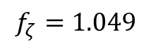
Criteria: Smean should not exceed more than 10%, the nominal value
$$f_{ζ}=1.049$$
Only 3 lines with slight violation of the limits
Lines violating Smax value
7.28%
Smean=6.72
Smax=6.26
3.84%
Snom=5.69
0.8%
Note that this index is based on the average value

Slide 8
Overloads: Case study 2
Case study: 118 lines, sever disturbance at 10 sec.
Analyzed window

Slide 9
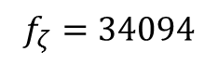
Criteria: Smean should not exceed more than 10%, the nominal value
$$f_{ζ}=34094$$
43 lines violating the limits
Smean=195.5
Smax=21.26
Snom=19.3

Slide 10
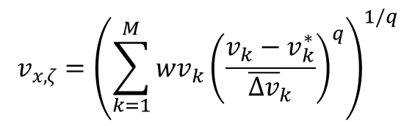
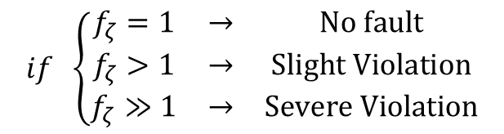
2. Post-fault Under-/Over-Voltage Index
Indicates whether or not the bus voltages deviations exceed those acceptable in the grid code, by observing the voltage across the transmission network after a contingency has occurred.
Bus voltage magnitudes
(from dynamic simulation)
Rated voltage
(from network data)
Weighting factor
i.e. wvk=[1,1,…,1] for a uniform weight
Parameter (from choosing a q-norm)
maximum acceptable voltage deviation (from the network data)
$$if \left\{\begin{matrix}f_{ζ}=1 & → & No fault \\ f_{ζ}>1 & → & Slight Violation \\ f_{ζ}≫1 & → & Severe Violation\end{matrix}\right.$$
Index Classification
The index is not a simple summation and we can use weights vx,k to give more importance to specific nodes.

Slide 11
Under/over Voltage: Case study 1
Case study: 50 buses, disturbance at 10sec
Analyzed window

Slide 12
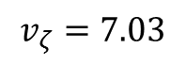
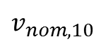
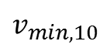
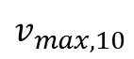
$$v_{ζ}=7.03$$
$$v_{max,10}$$
Only 5 buses with slight violation of the limits
$$v_{nom,10}$$
$$v_{min,10}$$
Note that this index is based on the average value.

Slide 13
Under/over Voltage: Case study 2
Case study: 6799 buses, severe disturbance at 62 sec.

Slide 14

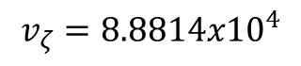
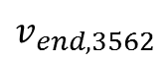
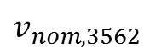
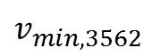
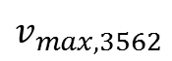
$$v_{max,3562}$$
$$v_{ζ}=8.8814{x10}^{4}$$
$$v_{min,3562}$$
$$v_{nom,3562}$$
15975 buses violating the limits
$$v_{end,3562}$$
$$Violation$$

Slide 15
3. Small-signal Stability Index
In this index the eigenvalues of the system from the dynamic simulation sequence are estimated using appropriate signal processing techniques.
Signal processing
for eigenvalues estimation
A measure of the stability of the system will be the damping ratio of the system, where the requirement of a stable case could be set to a damping ratio of for example 5%.

Slide 16
Small-signal Case study
Case study: 6799 buses, disturbance at 2 sec.
Signals with highest oscillatory content

Slide 17
Signal Processing and eigenvalue estimation
One inter-area mode (0.66Hz) identified with ζ=1% damping ratio
Simulation classified as unstable
(minimum ζ=5% )

Slide 18
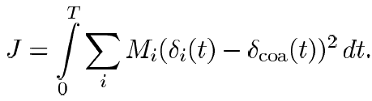
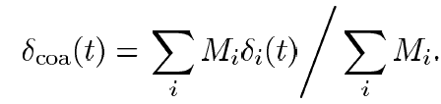
4. Transient stability (rotor-angle stability)
To evaluate the transient stability of the system, a simple approach that looks at the angular deviation from the center of inertia angle has ben chosen. In this way we can see if any uncontrolled inter-area oscillations (loss of synchronism) exist. The multimachine integral square generator angle index (ISGA) is used.
Generator angles
Machines inertias (2 *H)
Center of angle (COA)

Slide 19
Transient Stability: case study 1
Case study: 772 machines, different disturbances at 2, 22, 42 and 62 sec, total simulation length of 82 sec.
Analyzing TS after disturbance at 2 sec

Slide 20
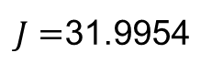
$J=$31.9954
No transient stability
Note that might be required to normalize this index

Slide 21
Transient Stability: case study 2
Case study: 772 machines, disturbances at 2, 22, 42 and 62 sec, total simulation length of 82 sec.
Analyzing TS after last disturbance at 62 sec

Slide 22
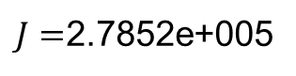
$J=$2.7852e+005
Severe transient stability problem

Slide 23
Main Challenges
Related to integration of the proposed algorithms:
Interaction and information exchange among the different partners
The indices validated using dynamic simulations from our different partners.
Large amount of information to analyze
Integrate the final algorithms with all of the partners
Computational challenges:
Automation of index computations
Severity index capability to forecast:
An actual stability condition in the grid (… are the models good enough?)
Capability to discern the originating instability failure mode (e.g. small signal, voltage…) in grid collapse scenarios where different (or all) types of instability are involved

Slide 24
THANKS! QUESTIONS?

